Slide 1
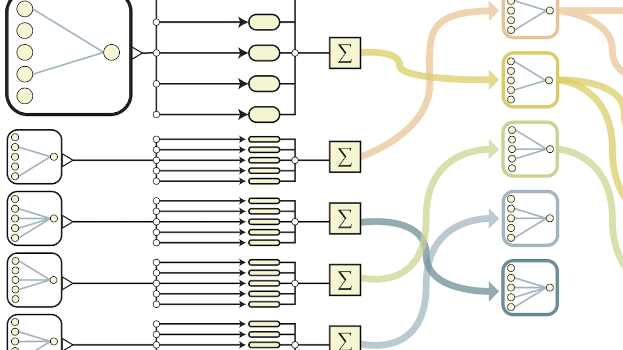
Wahlfach
Neuronale Netze - KI in der Medizin

Slide 2
Themen des Wahlfachs
So., 10.12.2023
Crashkurs Python
Sa., 16.12.2023
Crashkurs Machine Learning
So., 17.12.2023
Crashkurs Deep Learning

Slide 3
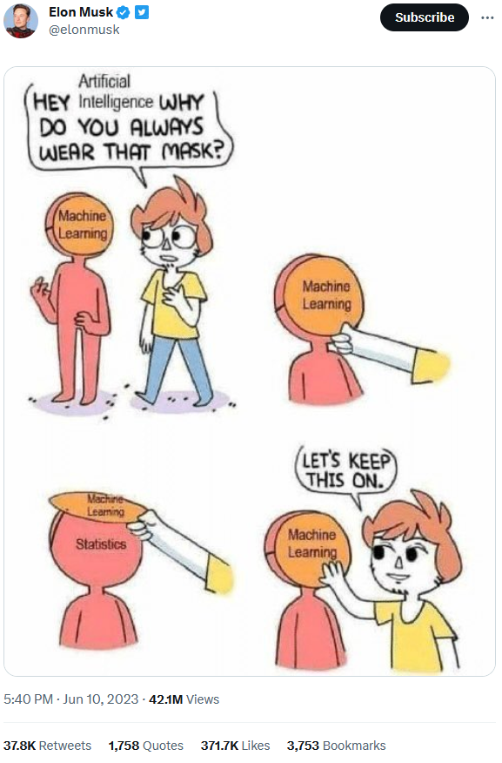

Was ist überhaupt machine learning?

Slide 4
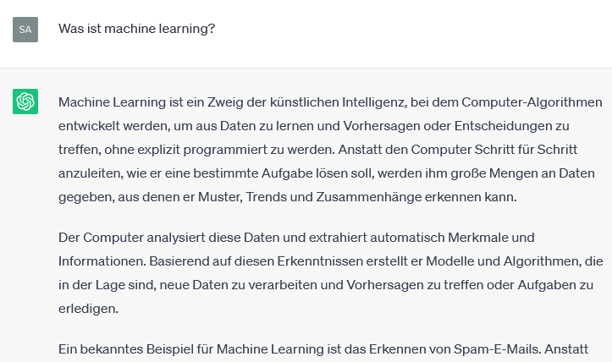
Was ist überhaupt machine learning?

Slide 5

KI gibt es schon seit Jahrzehnten…

Slide 6
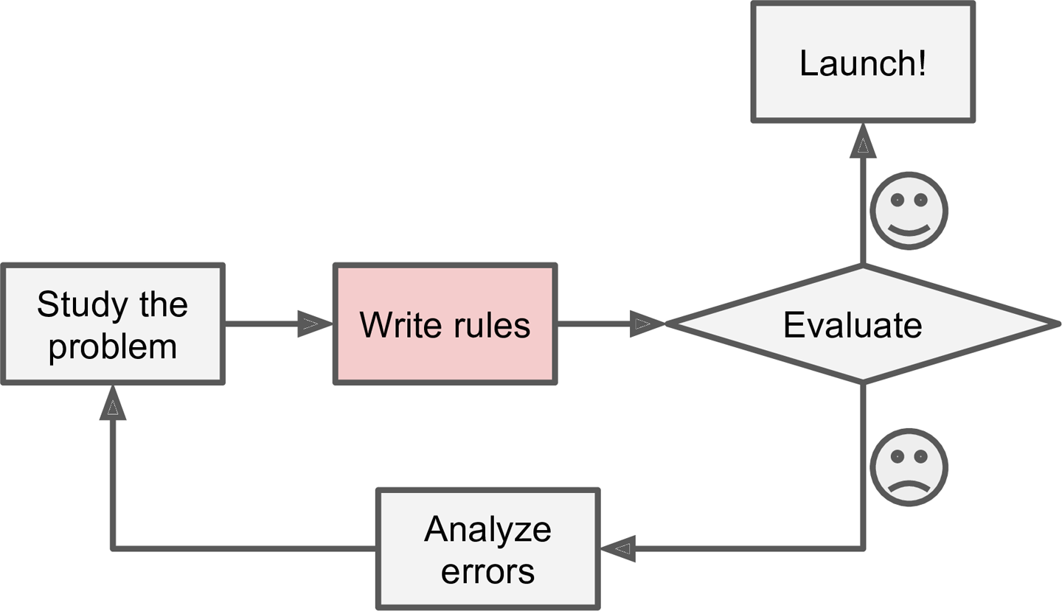
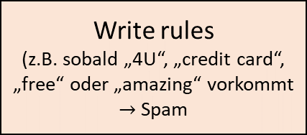
Wie baut man einen Spam-Filter? – The traditional approach
Launch!
Study the problem
(z.B. Wie sieht eine Spam-Mail typischerweise aus?)
Write rules
(z.B. sobald „4U“, „credit card“, „free“ oder „amazing“ vorkommt $→$ Spam
Evaluate
Analyze errors

Slide 7
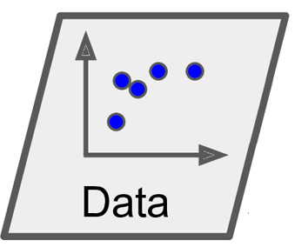
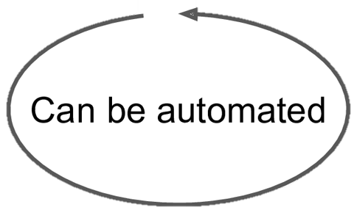
Wie baut man einen Spam-Filter? – The Machine Learning approach
Update data
Launch!
Study the problem
(z.B. Was ist das grundlegende Prinzip von Spam-Filtern?
Train Machine Learning algorithm
Evaluate
Analyze errors

Slide 8

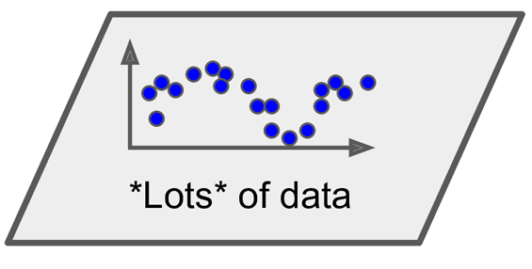

Wie baut man einen Spam-Filter? – The Data Mining approach
Study the problem
(z.B. Was ist das grundlegende Prinzip von Spam-Filtern?
Train Machine Learning algorithm
Inspect the solution
Understand the problem better

Slide 9
Was ist nun Machine Learning?

Slide 10

Wie funktioniert aber nun dieser Algorithmus?
Update data
Launch!
Study the problem
(z.B. Was ist das grundlegende Prinzip von Spam-Filtern?
Train Machine Learning algorithm
Evaluate
Analyze errors

Slide 11
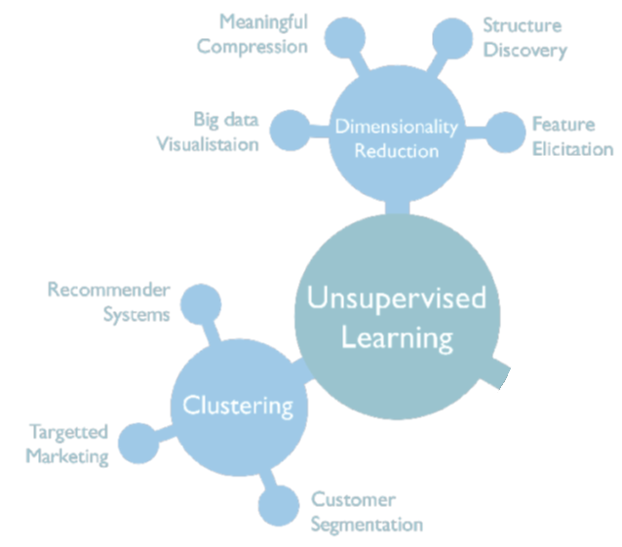
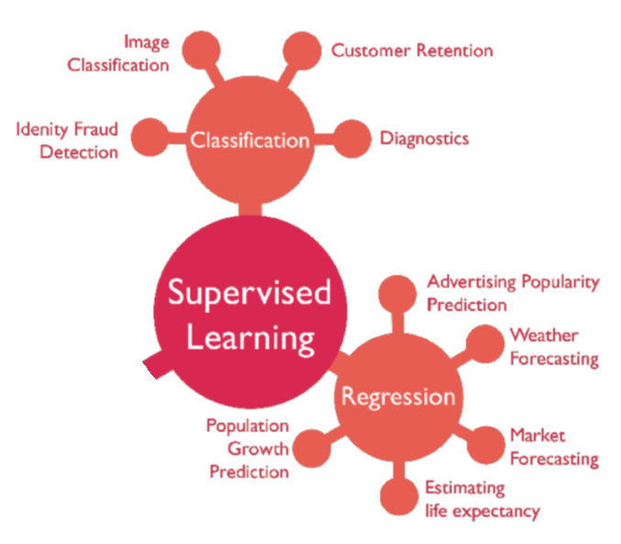
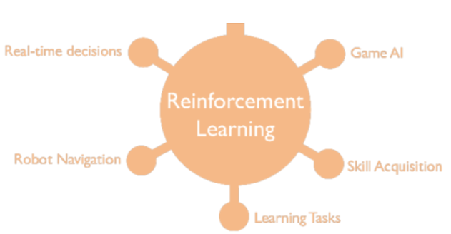
Types of Machine Learning Systems
Machine Learning

Slide 12
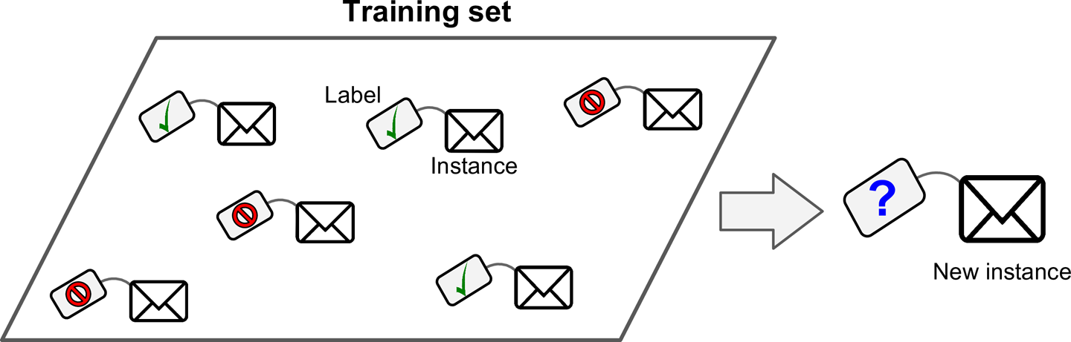
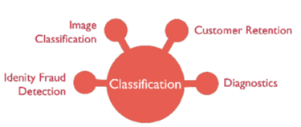
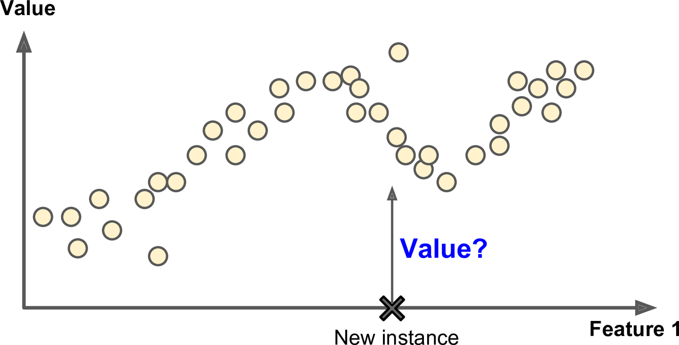
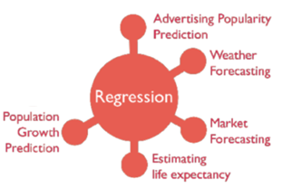
Supervised Learning
(z.B. Preis eines Gebrauchtwagens)
(z.B. gefahrene Kilometer)

Slide 13
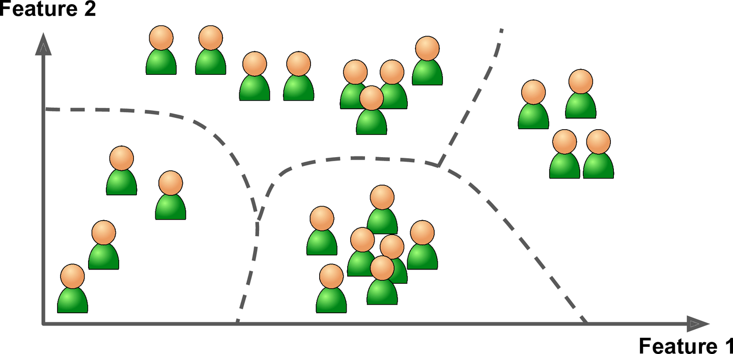
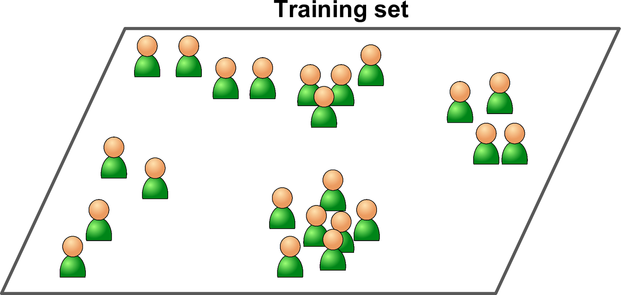
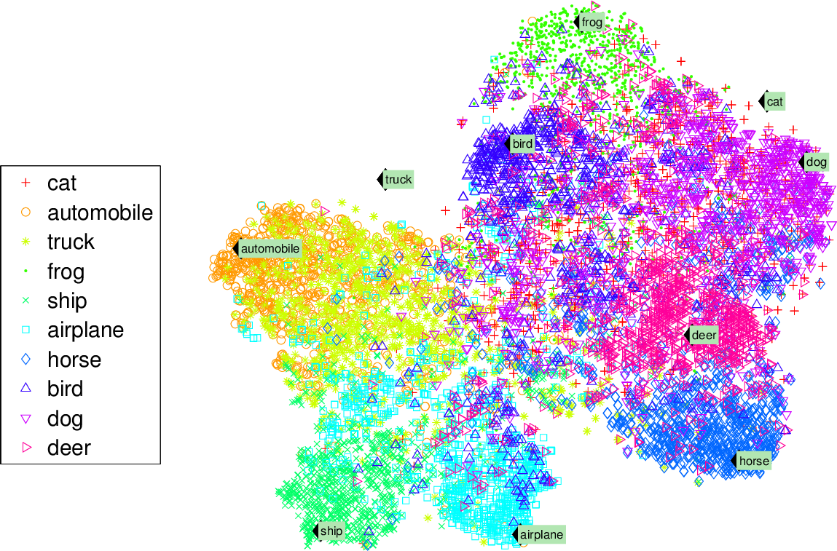
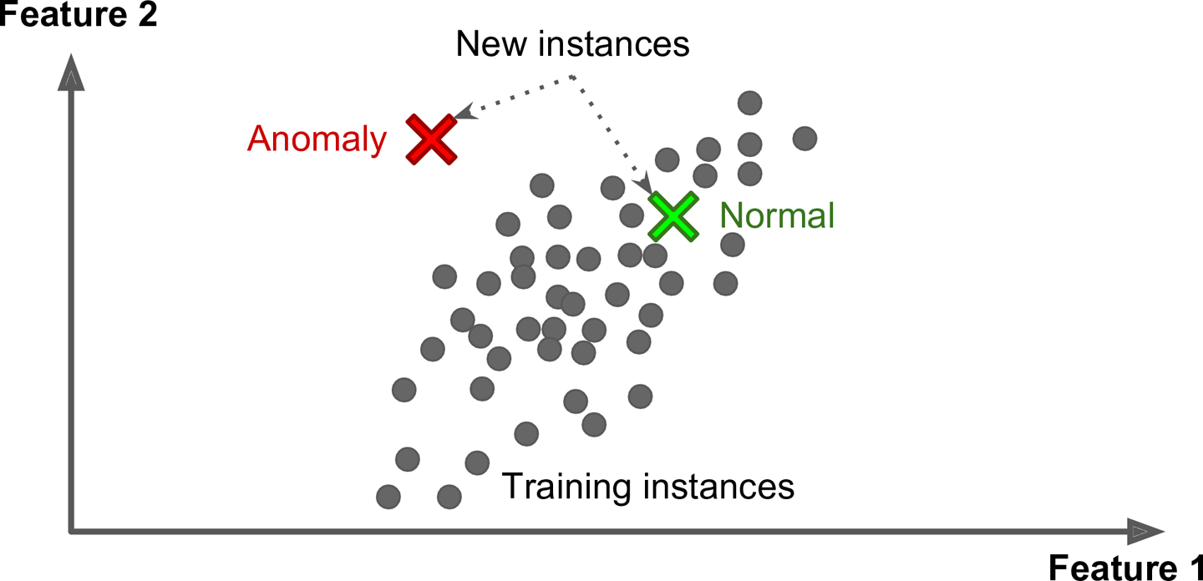
Unsupervised Learning

Slide 14

Reinforcement Learning

Slide 15
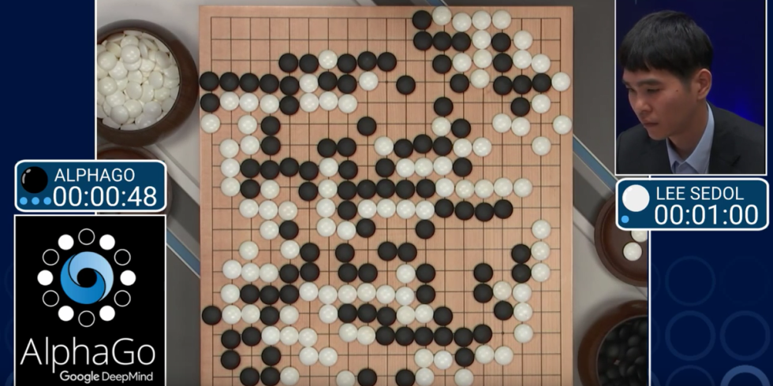
Reinforcement Learning

Slide 16
Types of Machine Learning Systems
Machine Learning

Slide 17
Wofür braucht man eigentlich Machine Learning in der Medizin?
Classification
Regression
Clustering
predicting classes:
predicting values:
predicting clustered data:
Diagnosis: healthy vs. unhealthy
Disease classification
Tumor staging
Clinial score prediction
Survival prediction
Find similar patient cohorts in unlabeled data
Anomaly detection

Slide 18
Beispiel: Classification – skin lesions diagnosis – KI vs. Arzt

Slide 19
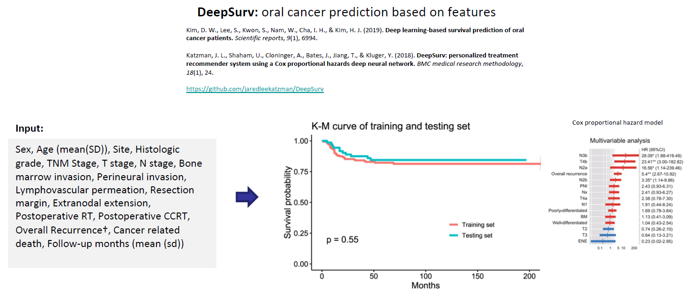
Beispiel: Regression – survival prediction

Slide 20
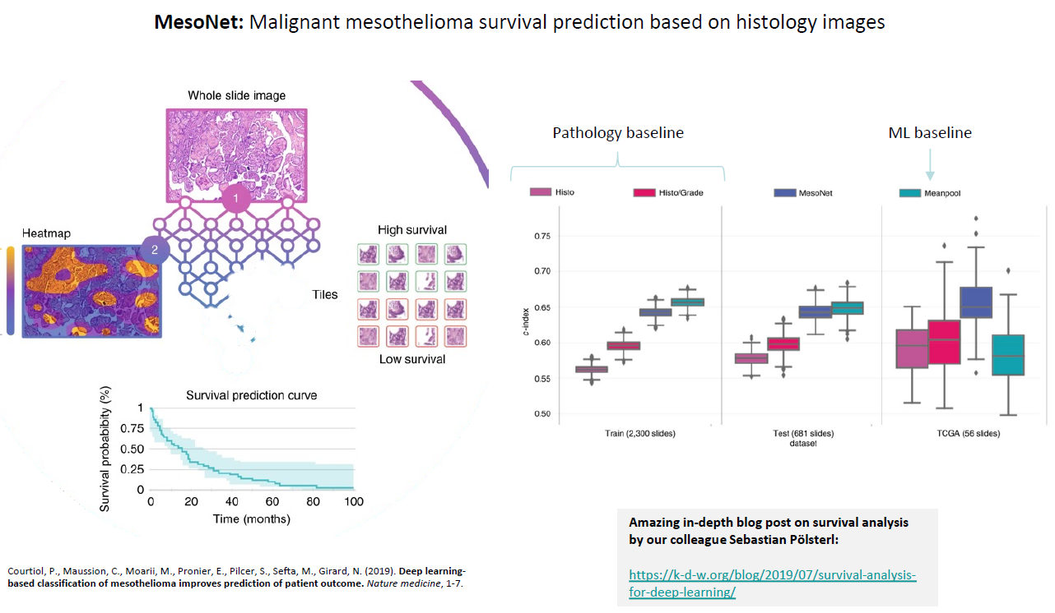
Beispiel: Regression – survival prediction

Slide 21
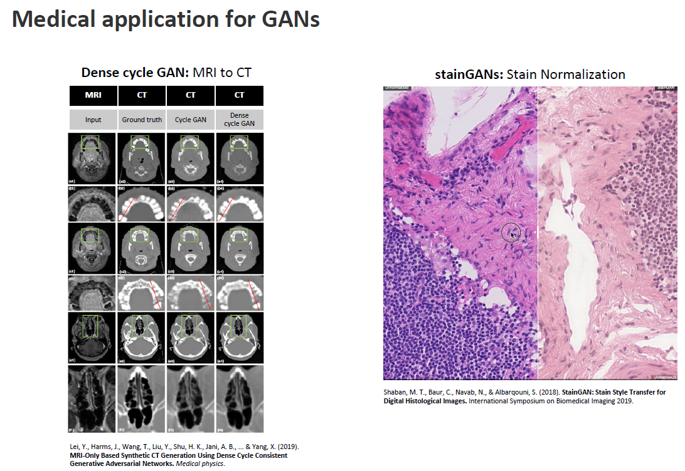
Komplexere Beispiele

Slide 22

Certified medical devices using AI

Slide 23

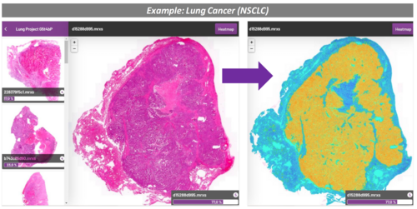


Erfolgreiche AI Start-Ups in Deutschland
Ada – Check Deine Gesundheit
Aignostics GmbH
Kaia Health
Cara Care: IBS, FODMAP Tracker

Slide 24
Types of Machine Learning Systems
Machine Learning

Slide 25
Supervised Learning

Slide 26

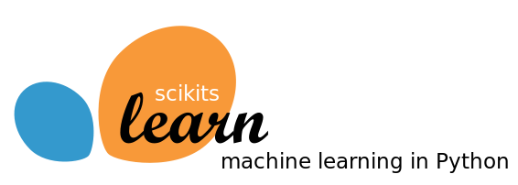

Slide 27
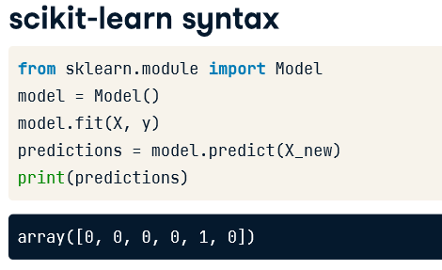
Die grundlegende scikit-learn Syntax
Build a model
Model learns from the labeled data we pass to it.
Pass unlabeled data to the model as input.
Model predicts the labels of the unseen data.
predicting continuous variables
predicting categorical variables
Regression
Classification/ Clustering

Slide 28
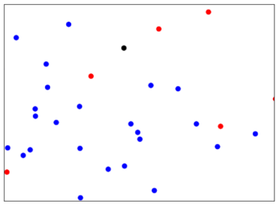
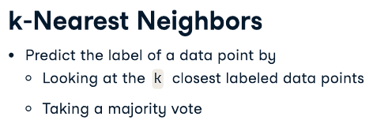
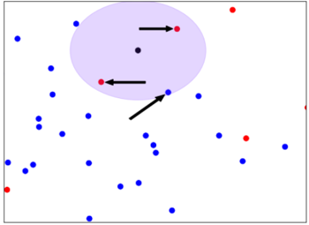
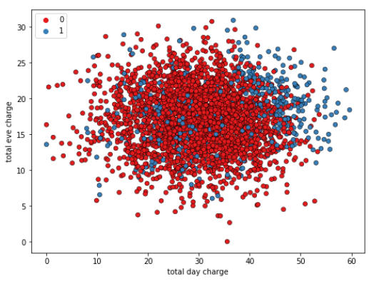
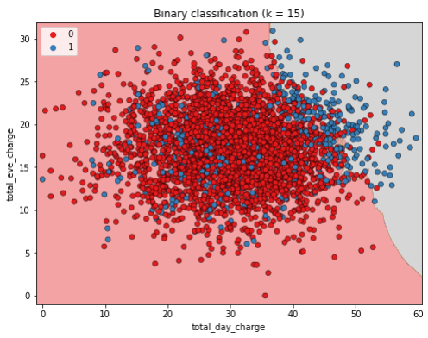
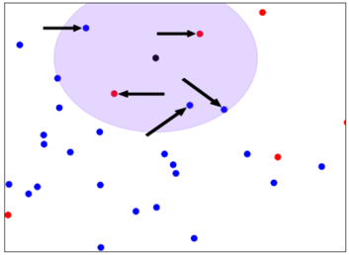
K-Nearest Neighbors: Konzept
k = 3
k = 5

Slide 29

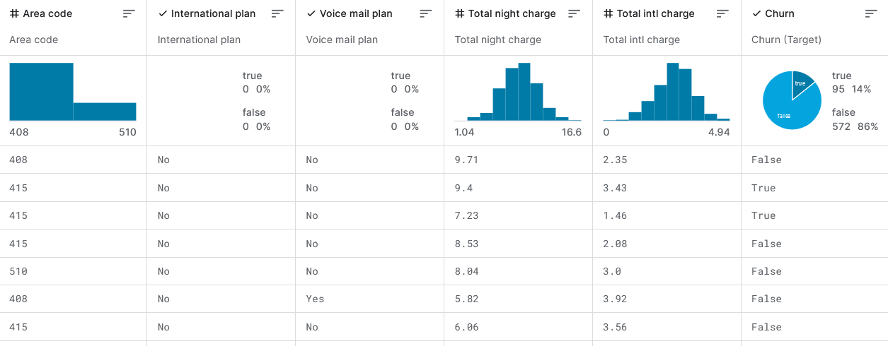
K-Nearest Neighbors: Der Datensatz
Context
"Predict behavior to retain customers. You can analyze all relevant customer data and develop focused customer retention programs.“
Content
The Orange Telecom's Churn Dataset, which consists of cleaned customer activity data (features), along with a churn label specifying whether a customer canceled the subscription, will be used to develop predictive models.

Slide 30
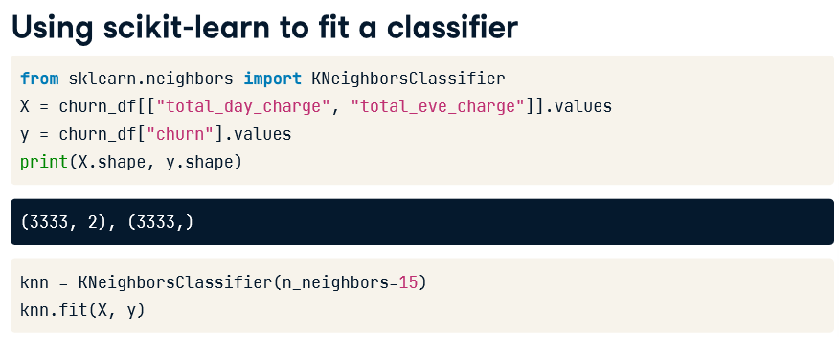
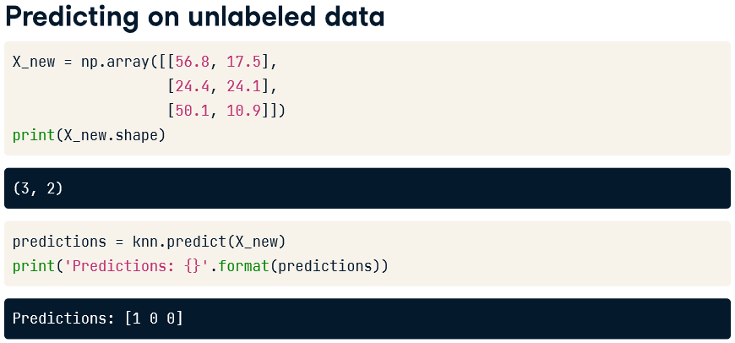
K-Nearest Neighbors: Umsetzung

Slide 31
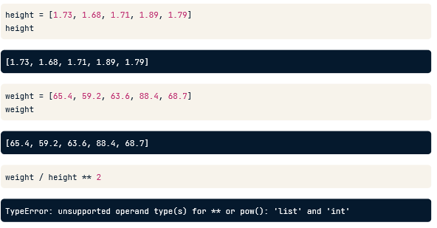
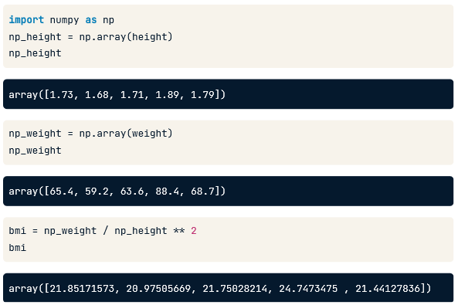
EXKURS: Numpy arrays
Solution: numpy arrays

Slide 32
K-Nearest Neighbors: Umsetzung

Slide 33
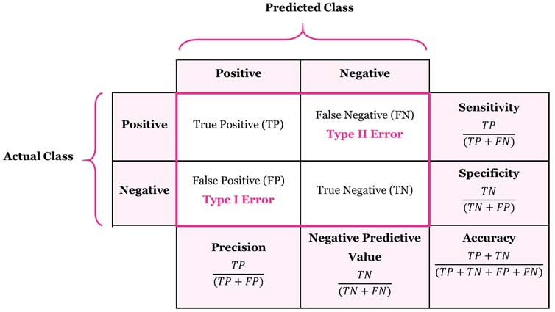
Wie misst man die Performance eines Models?

Slide 34
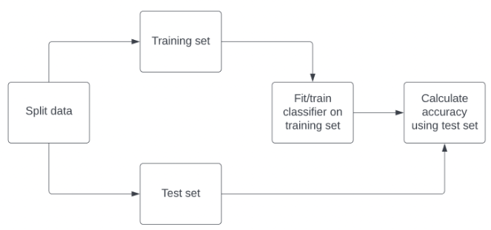
Wie misst man die Performance eines Models?

Slide 35
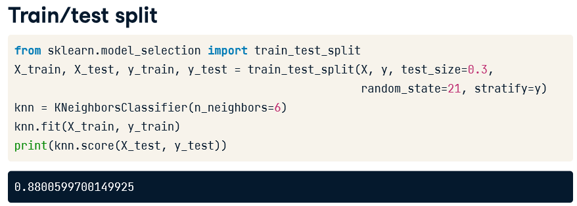
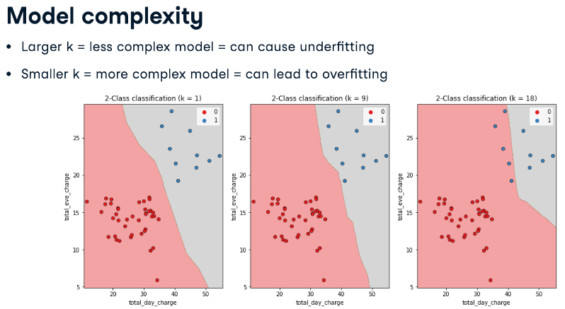
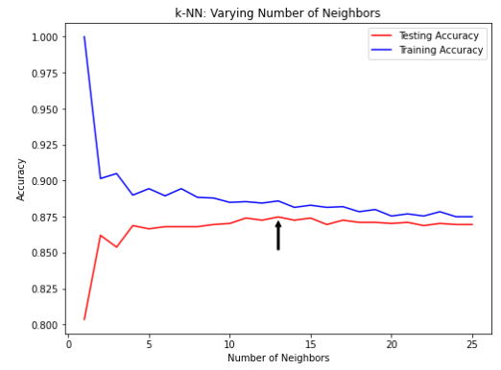
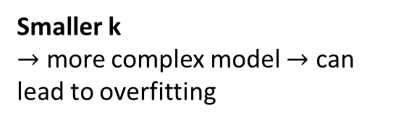
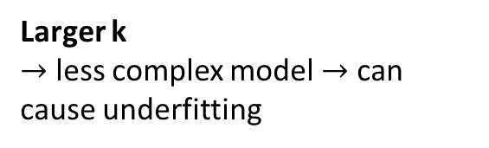
Wie misst man die Performance eines Models?
Larger k
$→$ less complex model $→$ can cause underfitting
Smaller k
$→$ more complex model $→$ can lead to overfitting

Slide 36

Auf zu Colab!
Supervised Learning with scikit-learn

Slide 37
Supervised Learning

Slide 38
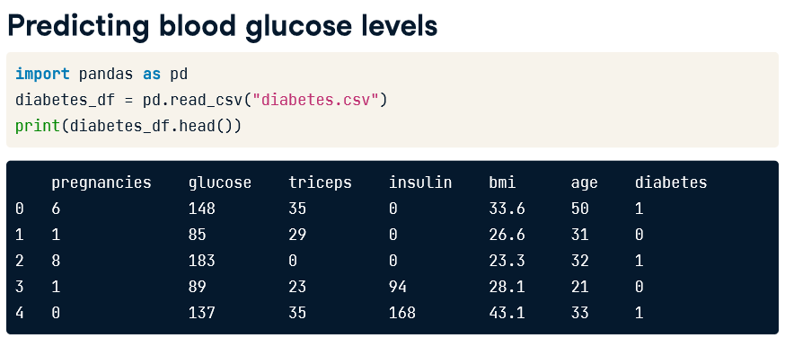
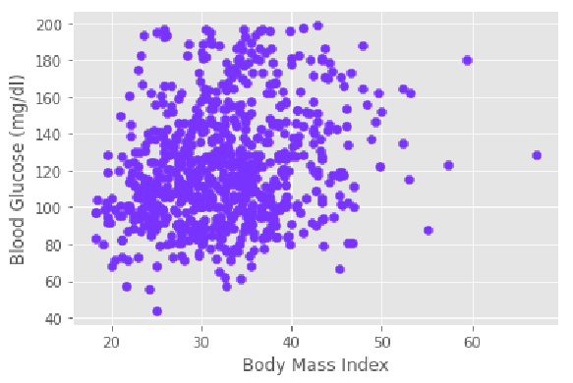
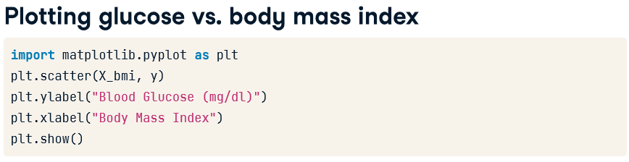
Wie misst man die Performance eines Models?

Slide 39
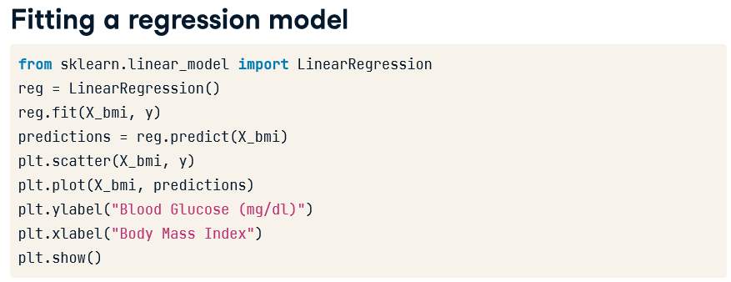
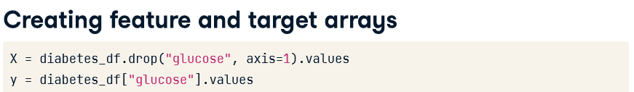
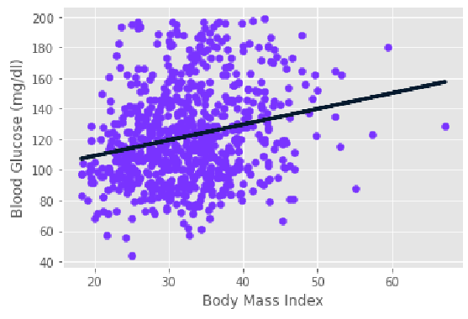

Regression einfach gedacht: How to predict blood glucose levels from only a single feature?

Slide 40

Aber was ist jetzt eigentlich linear regression?

Slide 41







Aber was ist jetzt eigentlich linear regression?
Notes:
Let's visualize a loss function using this scatter plot. We want the line to be as close to the observations as possible. Therefore, we want to minimize the vertical distance between the fit and the data. So for each observation, we calculate the vertical distance between it and the line. This distance is called a residual. We could try to minimize the sum of the residuals, but then each positive residual would cancel out each negative residual. To avoid this, we square the residuals. By adding all the squared residuals, we calculate the residual sum of squares, or RSS. This type of linear regression is called Ordinary Least Squares, or OLS, where we aim to minimize the RSS.

Slide 42




Wie misst man die Performance eines Regression Models?
Notes:
The default metric for linear regression is R-squared, which quantifies the amount of variance in the target variable that is explained by the features. Values can range from zero to one, with one meaning the features completely explain the target's variance. Here are two plots visualizing high and low R-squared respectively.
To compute R-squared, we call the model's dot-score method, passing the test features and targets. Here the features only explain about 35 percent of blood glucose level variance.
Another way to assess a regression model's performance is to take the mean of the residual sum of squares. This is known as the mean squared error, or MSE. MSE is measured in units of our target variable, squared. For example, if a model is predicting a dollar value, MSE will be in dollars squared. To convert to dollars, we can take the square root, known as the root mean squared error, or RMSE.
To calculate RMSE, we import mean_squared_error from sklearn-dot-metrics, then call mean_squared_error. We pass y_test and y_pred, and set squared equal to False, which returns the square root of the MSE. The model has an average error for blood glucose levels of around 24 milligrams per deciliter.
Now let's build and evaluate a multiple linear regression model!

Slide 43


Aber geht das auch mit mehrdimensionalen features?
Notes:
When we have two features, x1 and x2, and one target, y, a line takes the form y = a1x1 + a2x2 + b. So to fit a linear regression model we specify three variables, a1, a2, and the intercept, b. When adding more features, it is known as multiple linear regression. Fitting a multiple linear regression model means specifying a coefficient, a n, for n number of features, and b. For multiple linear regression models, scikit-learn expects one variable each for feature and target values.
Let's perform linear regression to predict blood glucose levels using all of the features from the diabetes dataset. We import LinearRegression from sklearn-dot-linear_model. Then we split the data into training and test sets, instantiate the model, fit it on the training set, and predict on the test set. Note that linear regression in scikit-learn performs OLS under the hood.

Slide 44
Auf zu Colab!
Supervised Learning with scikit-learn

Slide 45










Warum Cross-Validation?
Notes:
We begin by splitting the dataset into five groups or folds. Then we set aside the first fold as a test set, fit our model on the remaining four folds, predict on our test set, and compute the metric of interest, such as R-squared. Next, we set aside the second fold as our test set, fit on the remaining data, predict on the test set, and compute the metric of interest. Then similarly with the third fold, the fourth fold, and the fifth fold. As a result we get five values of R-squared from which we can compute statistics of interest, such as the mean, median, and 95% confidence intervals. As we split the dataset into five folds, we call this process 5-fold cross-validation. If we use 10 folds, it is called 10-fold cross-validation. More generally, if we use k folds, it is called k-fold cross-validation or k-fold CV. There is, however, a trade-off. Using more folds is more computationally expensive. This is because we are fitting and predicting more times.

Slide 46


Cross-Validation: Umsetzung
Notes:
To perform k-fold cross-validation in scikit-learn, we import cross_val_score from sklearn-dot-model_selection. We also import KFold, which allows us to set a seed and shuffle our data, making our results repeatable downstream. We first call KFold. The n_splits argument has a default of five, but in this case we assign six, allowing us to use six folds from our dataset for cross-validation. We also set shuffle to True, which shuffles our dataset before splitting into folds. We also assign a seed to the random_state keyword argument, ensuring our data would be split in the same way if we repeat the process making the results repeatable downstream. We save this as the variable kf. As usual, we instantiate our model, in this case, linear regression. We then call cross_val_score, passing the model, the feature data, and the target data as the first three positional arguments. We also specify the number of folds by setting the keyword argument cv equal to our kf variable. This returns an array of cross-validation scores, which we assign to cv_results. The length of the array is the number of folds utilized. Note that the score reported is R squared, as this is the default score for linear regression.
We can now print the scores. This returns six results ranging from zero-point-seven to approximately zero-point-seven-seven. We can calculate the mean score using np-dot-mean, and the standard deviation using np-dot-std. Additionally, we can calculate the 95% confidence interval using the np-dot-quantile function, passing our results followed by a list containing the upper and lower limits of our interval as decimals.
Now let's apply k-fold cross-validation on our sales dataset!

Slide 47

Was ist Regularized Regression?
Ridge Regression
Lasso Regression
Notes:
Recall that fitting a linear regression model minimizes a loss function to choose a coefficient, a, for each feature, and the intercept, b. If we allow these coefficients to be very large, we can get overfitting. Therefore, it is common practice to alter the loss function so that it penalizes large coefficients. This is called regularization.

Slide 48


Ridge Regression
Notes:
The first type of regularized regression that we'll look at is called ridge. With ridge, we use the Ordinary Least Squares loss function plus the squared value of each coefficient, multiplied by a constant, alpha. So, when minimizing the loss function, models are penalized for coefficients with large positive or negative values. When using ridge, we need to choose the alpha value in order to fit and predict. Essentially, we can select the alpha for which our model performs best. Picking alpha for ridge is similar to picking k in KNN. Alpha in ridge is known as a hyperparameter, which is a variable used for selecting a model's parameters. Alpha controls model complexity. When alpha equals zero, we are performing OLS, where large coefficients are not penalized and overfitting may occur. A high alpha means that large coefficients are significantly penalized, which can lead to underfitting.
To perform ridge regression in scikit-learn, we import Ridge from sklearn-dot-linear_model. To highlight the impact of different alpha values, we create an empty list for our scores, then loop through a list of different alpha values. Inside the for loop we instantiate Ridge, setting the alpha keyword argument equal to the iterator, also called alpha. We fit on the training data, and predict on the test data. We save the model's R-squared value to the scores list. Finally, outside of the loop, we print the scores for the models with five different alpha values. We see performance gets worse as alpha increases.

Slide 49


Lasso Regression
Notes:
There is another type of regularized regression called lasso, where our loss function is the OLS loss function plus the absolute value of each coefficient multiplied by some constant, alpha. To use Lasso we import it from sklearn-dot-linear_model. The actual method for performing lasso regression in scikit-learn mirrors ridge regression, as we can see here. Performance drops substantially as alpha goes over 20!

Slide 50



Lasso Regression for feature selection
Notes:
Lasso regression can actually be used to assess feature importance. This is because it tends to shrink the coefficients of less important features to zero. The features whose coefficients are not shrunk to zero are selected by the lasso algorithm. Let's check this out in practice.
We import Lasso. Next, we create our feature and target arrays, and use the dataset's dot-columns attribute to access the feature names and store as the variable names. As we are calculating feature importance we use the entire dataset, rather than splitting it. We then instantiate Lasso, setting alpha to zero-point-one. We fit the model to the data and extract the coefficients using the dot-coef-underscore attribute, storing as lasso_coef. We then plot the coefficients for each feature.
We can see that the most important predictor for our target variable, blood glucose levels, is the binary value for whether an individual has diabetes or not! This is not surprising, but is a great sanity check. This type of feature selection is very important because it allows us to communicate results to non-technical audiences. It is also useful for identifying which factors are important predictors for various physical phenomena.
Now let's apply regularization to our regression models!

Slide 51
Auf zu Colab!
Supervised Learning with scikit-learn

Slide 52
Wie misst man die Performance eines Models?

Slide 53



Confusion Matrix: Umsetzung in Python
Notes:
Using our churn dataset, to compute the confusion matrix, along with the metrics, we import classification_report and confusion_matrix from sklearn-dot-metrics. We instantiate our classifier, split the data, fit the training data, and predict the labels of the test set.
We pass the test set labels and the predicted labels to the confusion matrix function. We can see 1106 true negatives in the top left.
Passing the same arguments to classification report outputs all the relevant metrics. It includes precision and recall by class, point-seven-six and point-one-six for the churn class respectively, which highlights how poorly the model's recall is on the churn class. Support represents the number of instances for each class within the true labels.
Now let's evaluate a classification model using our diabetes dataset!

Slide 54



Weitere Metriken…
Precision
Recall
Notes:
Secondly, there are other important metrics we can calculate from the confusion matrix. Precision is the number of true positives divided by the sum of all positive predictions. It is also called the positive predictive value. In our case, this is the number of correctly labeled fraudulent transactions divided by the total number of transactions classified as fraudulent. High precision means having a lower false positive rate. For our classifier, this translates to fewer legitimate transactions being classified as fraudulent.
Recall is the number of true positives divided by the sum of true positives and false negatives. This is also called sensitivity. High recall reflects a lower false negative rate. For our classifier, it means predicting most fraudulent transactions correctly.
The F1-score is the harmonic mean of precision and recall. This metric gives equal weight to precision and recall, therefore it factors in both the number of errors made by the model and the type of errors. The F1 score favors models with similar precision and recall, and is a useful metric if we are seeking a model which performs reasonably well across both metrics.

Slide 55
Auf zu Colab!
Supervised Learning with scikit-learn

Slide 56


Was ist Logistic Regression?
Notes:
It's time to introduce another model: logistic regression. Despite its name, logistic regression is used for classification. This model calculates the probability, p, that an observation belongs to a binary class. Using our diabetes dataset as an example, if p is more than or equal to zero-point-five, we label the data as one, representing a prediction that an individual is more likely to have diabetes; if p is less than zero-point-five, we label it zero to represent that they are more likely to not have diabetes.
Note that logistic regression produces a linear decision boundary, as we can see in this image.

Slide 57



Umsetzung: Logistic Regression
Notes:
Using logistic regression in scikit-learn follows the same approach as used for other models. We first import LogisticRegression from sklearn-dot-linear_model. Next we instantiate the classifier, split our data, fit the model on our training data, and predict on our test set. In this video we use the churn dataset.
We can predict probabilities of each instance belonging to a class by calling logistic regression's predict_proba method and passing the test features. This returns a 2-dimensional array with probabilities for both classes, in this case, that the individual did not churn, or did churn, respectively. We slice the second column, representing the positive class probabilities, and store the results as y_pred_probs. Here we see the model predicts a probability of point-zero-eight-nine that the first observation has churned.
The default probability threshold for logistic regression in scikit-learn is zero-point-five. This threshold can also apply to other models such as KNN. So what happens as we vary this threshold?

Slide 58






The ROC curve
Notes:
We can use a receiver operating characteristic, or ROC curve, to visualize how different thresholds affect true positive and false positive rates. Here, the dotted line represents a chance model, which randomly guesses labels.
When the threshold equals zero, the model predicts one for all observations, meaning it will correctly predict all positive values, and incorrectly predict all negative values.
If the threshold equals one, the model predicts zero for all data, which means that both true and false positive rates are zero. If we vary the threshold, we get a series of different false positive and true positive rates. A line plot of the thresholds helps to visualize the trend.

Slide 59




The ROC curve
Notes:
To plot the ROC curve, we import roc_curve from sklearn-dot-metrics. We then call the function roc_curve; we pass the test labels as the first argument, and the predicted probabilities as the second. We unpack the results into three variables: false positive rate, FPR; true positive rate, TPR; and the thresholds. We can then plot a dotted line from zero to one, along with the FPR and TPR; to produce a figure such as this. This looks great, but how do we quantify the model's performance based on this plot?
If we have a model with one for true positive rate and zero for false positive rate, this would be the perfect model. Therefore, we calculate the area under the ROC curve, a metric known as AUC. Scores range from zero to one, with one being ideal. Here, the model scores point-six-seven, which is only 34% better than a model making random guesses. We can calculate AUC in scikit-learn by importing roc_auc_score from sklearn-dot-metrics. We call roc_auc_score, passing our test labels and our predicted probabilities, calculated by using the model's predict_proba method on X_test. As expected, we get a score of zero-point-six-seven.
Now let's build a logistic regression model and evaluate its performance!

